Slide 1
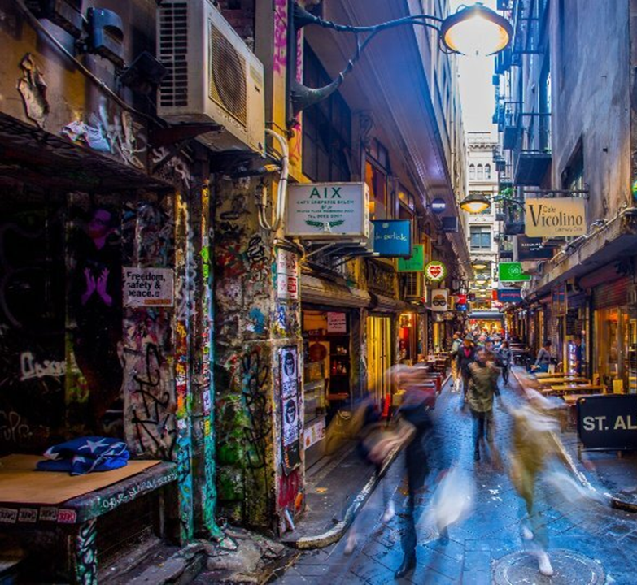
Eat & Drink
Melbourne (2002 – 2020)
David Salim
Ron Fu
Sam Vuong
Steven Bouios
Group 7
Notes:
Melbourne increasing in population – also known for its good food and café culture
See the increase of number of establishments in city of Melbourne and seating capacity to see the rate of growth over the years of 2002-2022
Which areas have a larger number (hotspot) of establishments and seating capacity

Slide 2
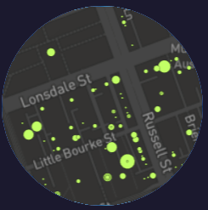


Agenda
Our story
Plan & Design
Coding Approaches
Data Munging
Process
Final visualisation - demo

Slide 3
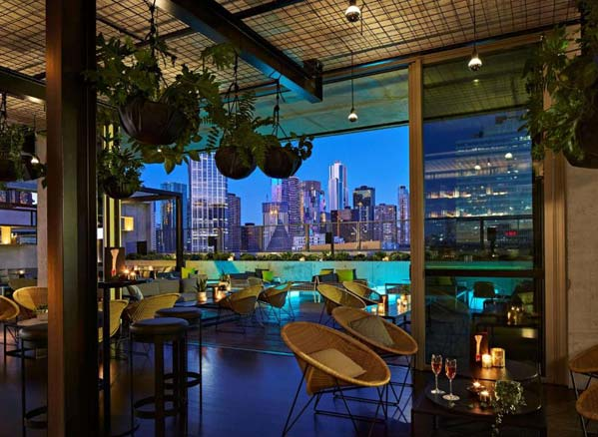
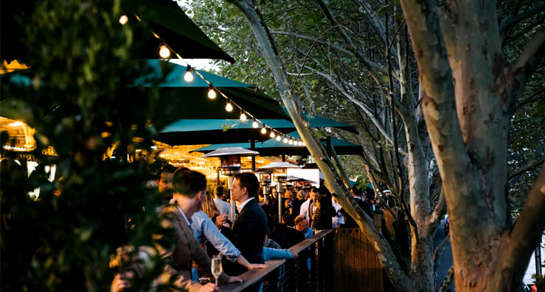
Our story
Cafes & Restaurants
City of Melbourne
2002 to 2022

Slide 4

Plan & Design
Dashboard
Table
Map

Slide 5
Coding approach
Dashboard
Table
Map

Slide 6
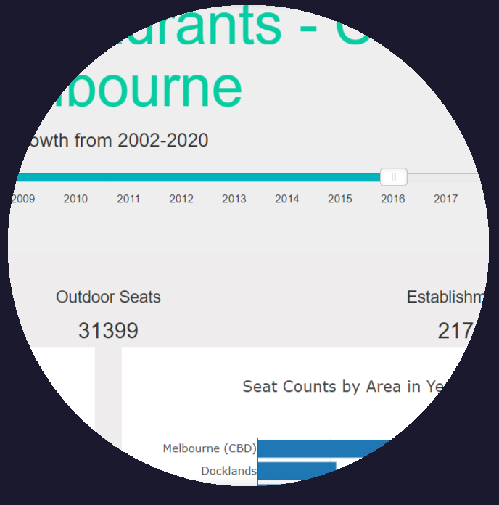
Dashboard
Slider (JS library)
Function to build charts
D3

Slide 7
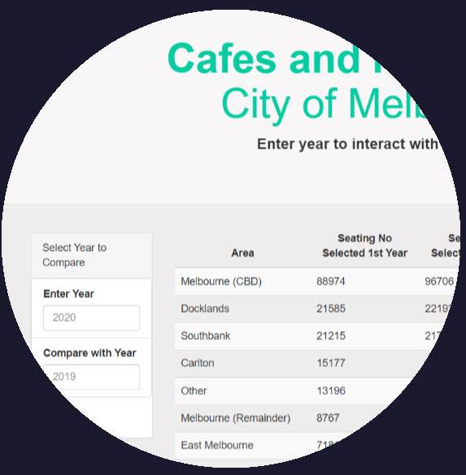
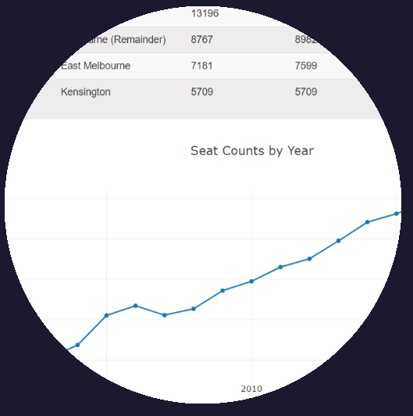
Table
D3
API – enter 2 different year input

Slide 8
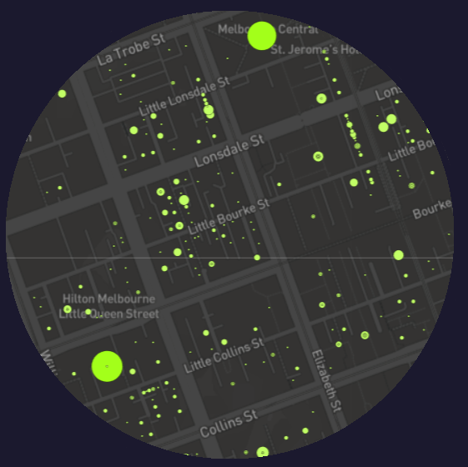
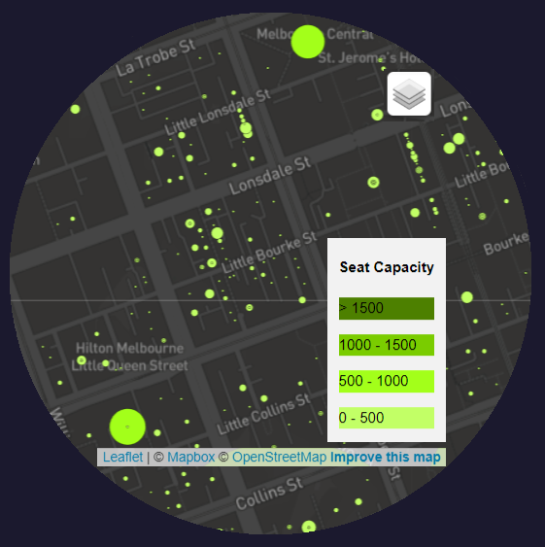
Map
Leaflet
Control layers:
Tile layers
Data by year

Slide 9
Data Munging

Slide 10
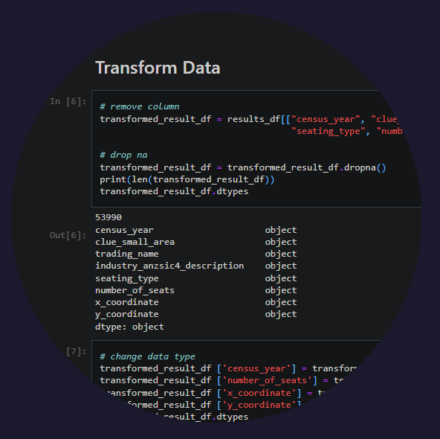
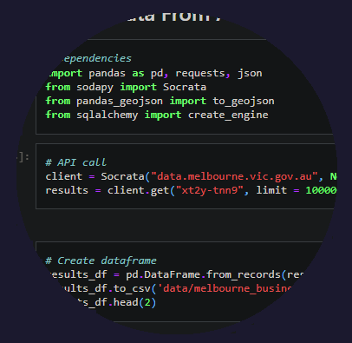
Data Munging
Pandas: dataframe
remove columns,
dropna,
drop duplicates,
change data type,
replace

Slide 11
Process

Slide 12
Process
melbourne.vic.gov.au
.ipynb
Python flask server
JS
API: chart
.csv
API: map
sqlite
API: table
.html

Slide 13
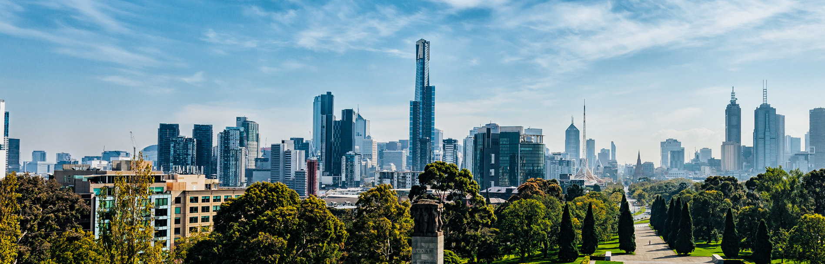
Demo

Slide 14


Thank You

